Slide 1
Open Source Database Project
Group 10
38 - Parmeet Singh Sandhu
39 - Kunal Sarpe
40 - Saumik Dutta
41 - Pallavi Sawant

Slide 2
Table of Contents
Product Inventory Management System
Queries
Event Management System
ER Diagram
Relational Model
Queries

Slide 3
Product Inventory Management System
Product inventory management system is a management system by which you can track your goods throughout your entire supply chain, from purchasing to production to end sales. This system has the capacity to store many different types of objects with different sets of attributes.
Customers in e-commerce stores regularly add and remove items from their “shopping cart,” change quantities multiple times, abandon the cart at any point, and sometimes have problems during and after checkout that require a hold or canceled order. These activities make it difficult to maintain inventory systems and counts and ensure that customers cannot “buy” items that are unavailable while they shop in your store.
This management system keeps the traditional metaphor of the shopping cart.

Slide 4
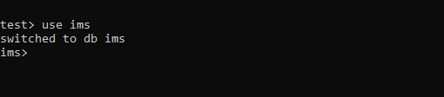
Creating database:

Slide 5

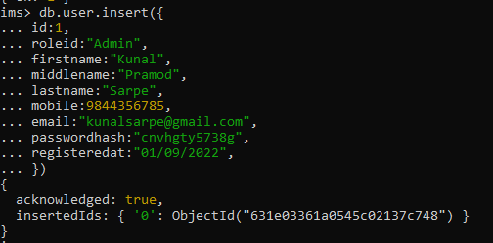
Creating collection “User”

Slide 6

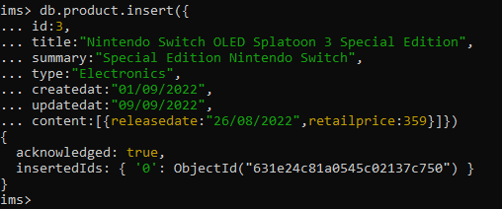
Creating collection “Product”

Slide 7

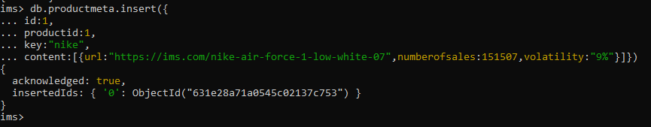
Creating collection “Product Meta”

Slide 8
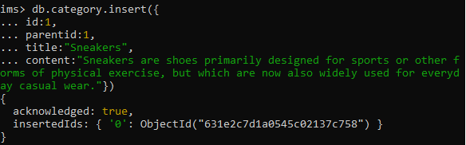
Creating collection “Category”

Slide 9
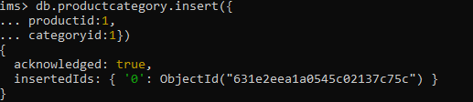
Creating collection “Product Category”

Slide 10

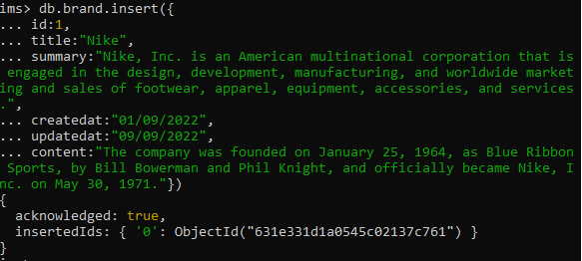
Creating collection “Brand”

Slide 11
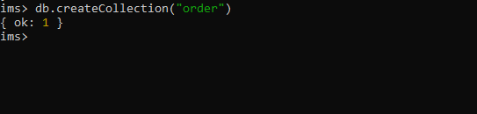
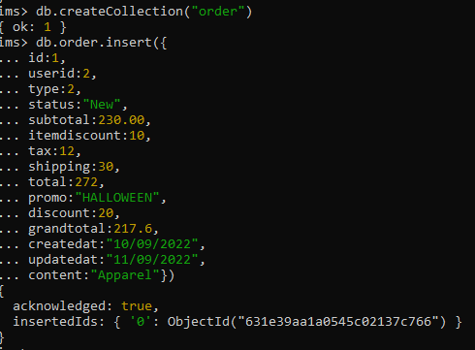
Creating collection “Order”

Slide 12
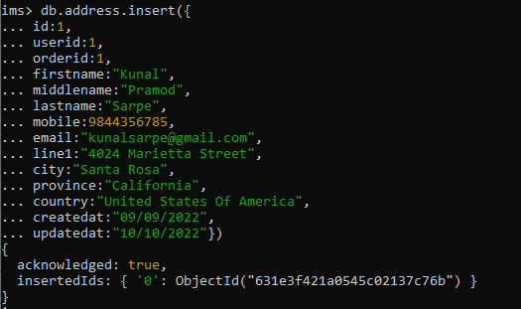
Creating collection “Address”

Slide 13
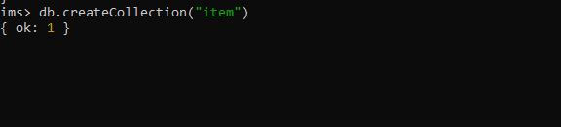
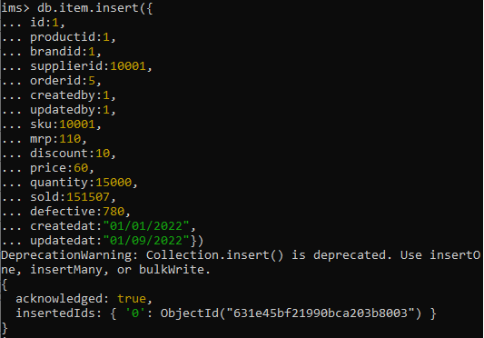
Creating collection “Item”

Slide 14

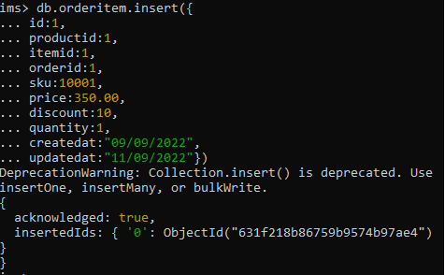
Creating collection “OrderItem”

Slide 15
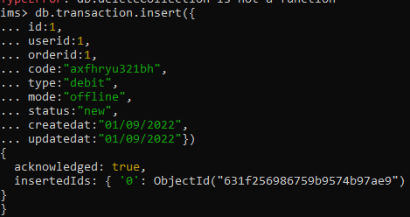
Creating collection “Transaction”

Slide 16
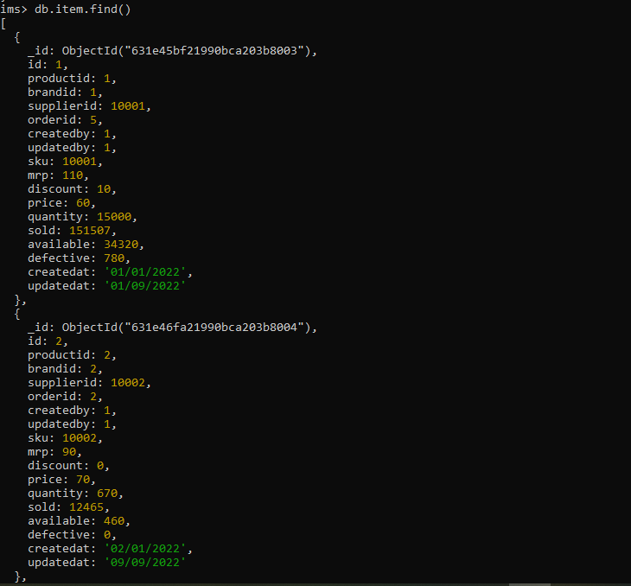
Queries
1] Field selection:
db.item.find()

Slide 17
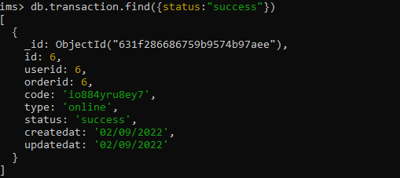
Queries
2] Condition clause: Where clause:
db.transaction.find({status:"success"})

Slide 18
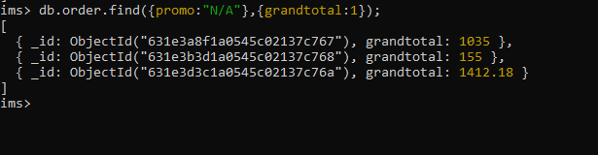
Queries
3] Projection: Select specific fields:
db.order.find({promo:"N/A"},{grandtotal:1});

Slide 19
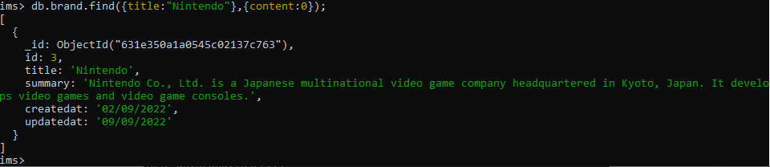
Queries
4] Field exclusion:
db.brand.find({title:"Nintendo"},{content:0});

Slide 20
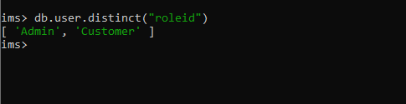
Queries
5] Get distinct status:
db.user.distinct("roleid")

Slide 21
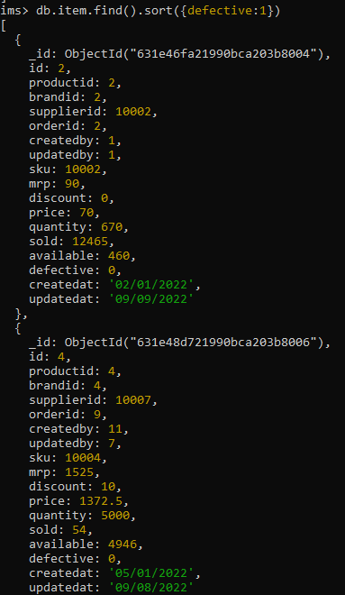
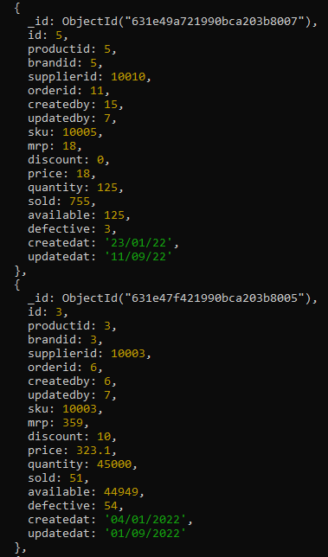
Queries
6] Sort:
db.item.find().sort({defective:1})

Slide 22
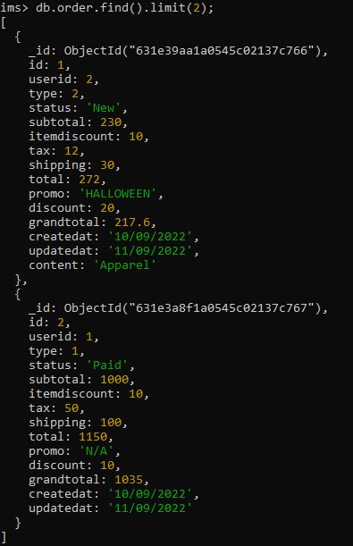
Queries
7] Limit:
db.order.find().limit(2);

Slide 23
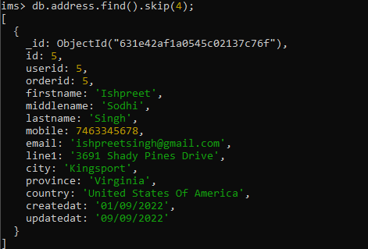
Queries
8] Skip:
db.address.find().skip(4);

Slide 24

Queries
9] Aggregate:
db.orderitem.find().count();

Slide 25

Queries
10] Group:
db.user.aggregate([{$group:{_id:"$roleid",user:{$push:"$firstname"}}}])

Slide 26
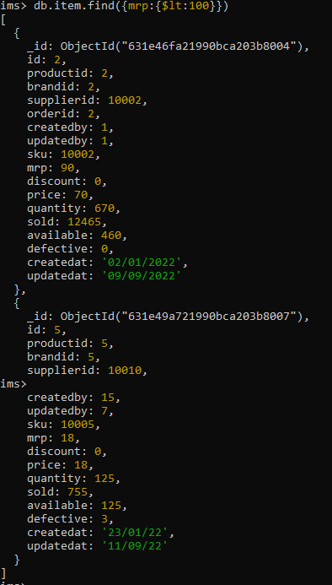
Queries
11] Comparison:
db.item.find({mrp:{$lt:100}})

Slide 27
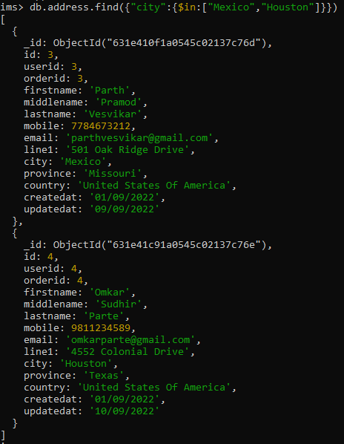
Queries
12] The following example query includes the $in operator, and will return documents whose city value matches either Mexico or Houston:
db.address.find({"city":{$in:["Mexico","Houston"]}})

Slide 28
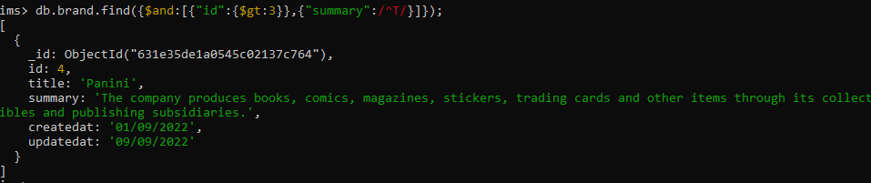
Queries
13] The following example query includes the $and operator and fetches brand details with summary starting with “T” and id greater than 3:
db.brand.find({$and:[{"id":{$gt:3}},{"summary":/^T/}]});

Slide 29
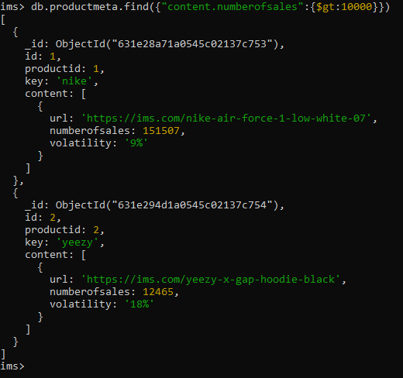
Queries
14] The following example query includes the . operator to demonstrate nested query and fetches productmeta details with numberofsales greater than 10000:
db.productmeta.find({"content.numberofsales":{$gt:10000}})

Slide 30
Queries
15] The following example query shows the demonstration of indexes in MongoDB:
db.order.find({"grandtotal":{$gt:1000}}).explain("executionStats")

Slide 31
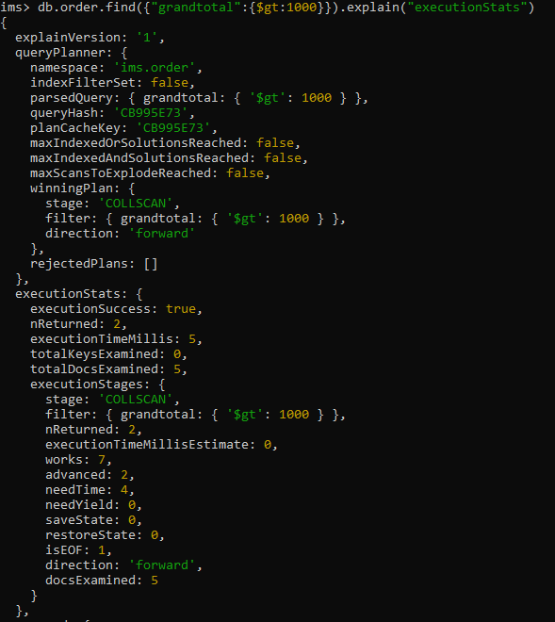

Slide 32

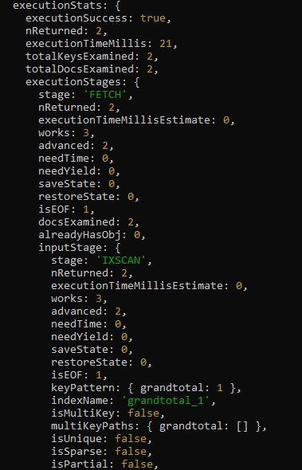

Slide 33
Thank You!

Slide 34
Event Management System (PostgreSql)

Slide 35
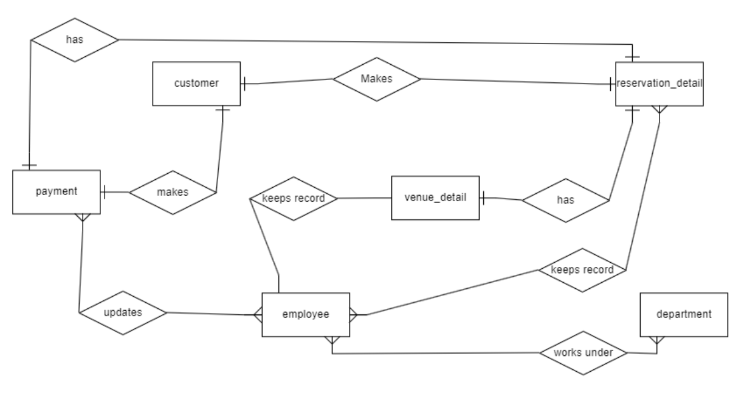
Entity Relationship Model

Slide 36
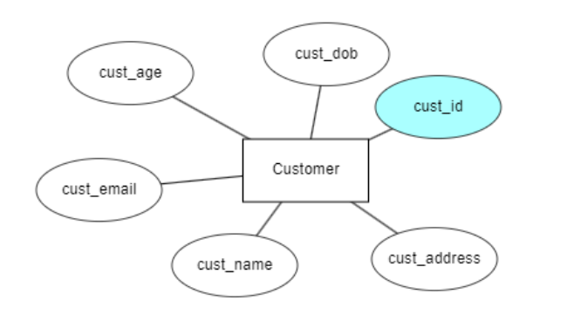
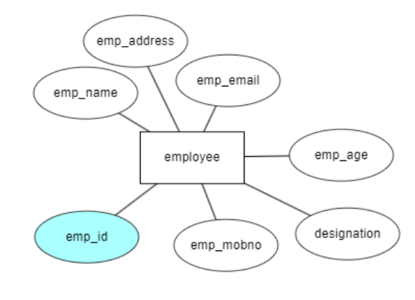
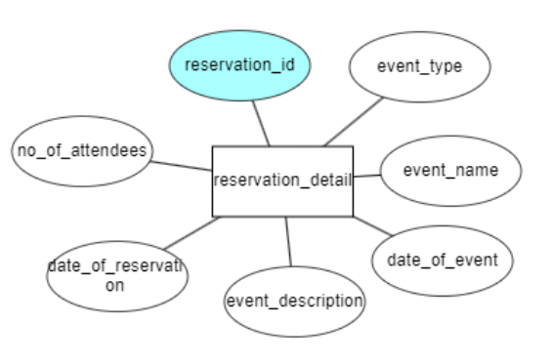
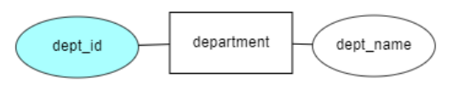

Slide 37
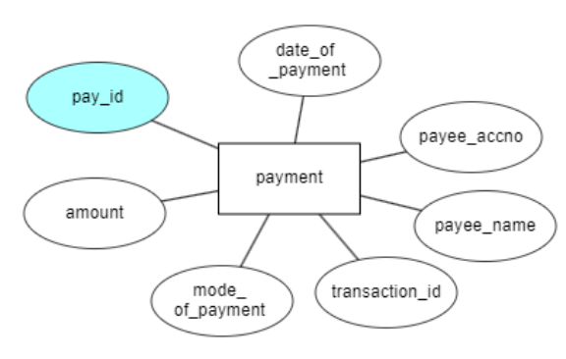
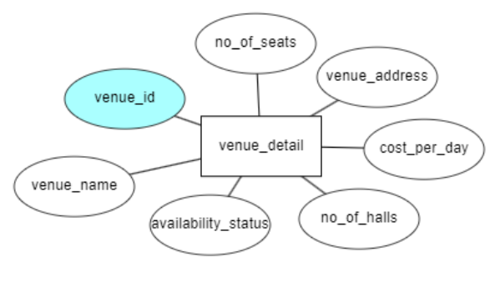

Slide 38
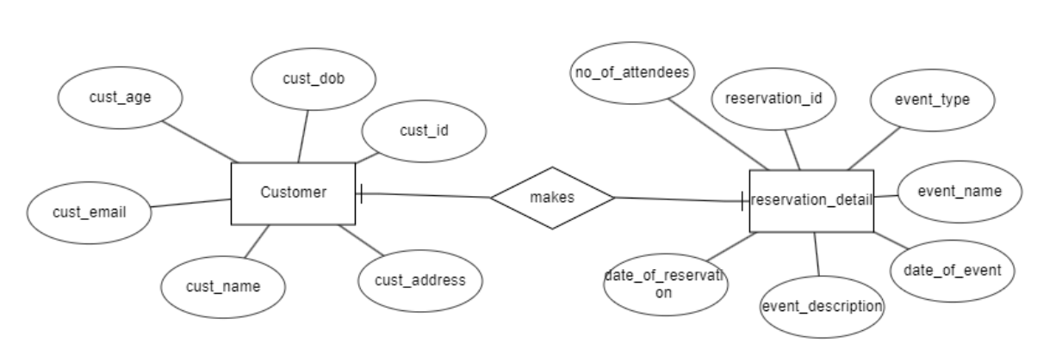
ER To Relational Model

Slide 39
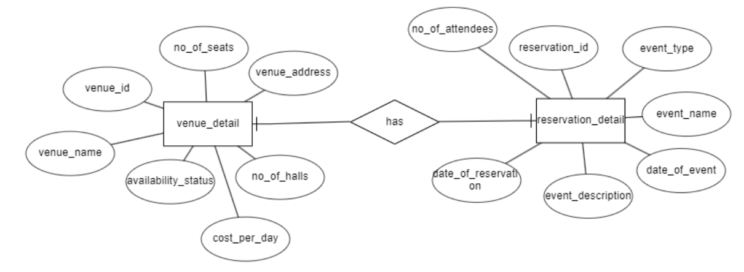
ER To Relational Model

Slide 40
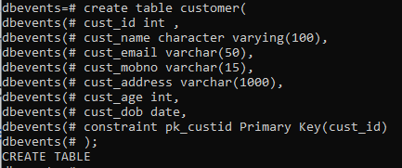

Customer

Slide 41
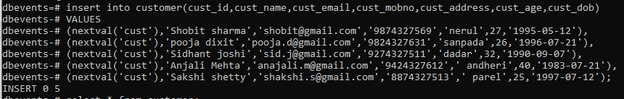
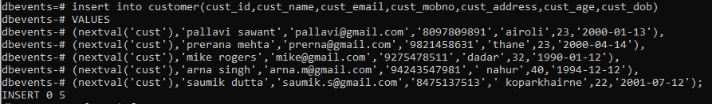
Customer

Slide 42
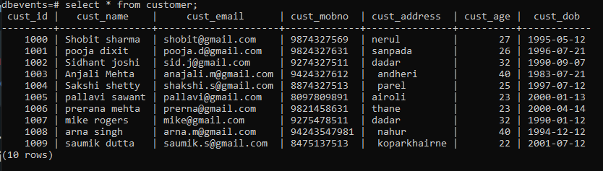
Customer

Slide 43


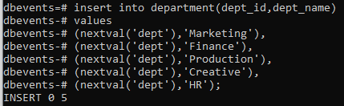
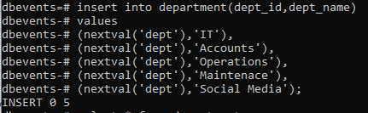
Department

Slide 44
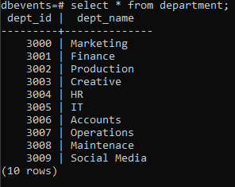
Department

Slide 45
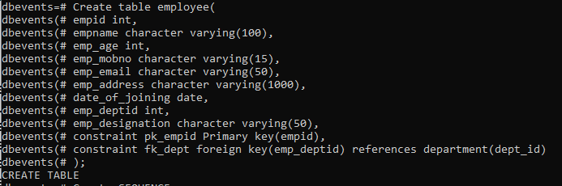

Employee

Slide 46
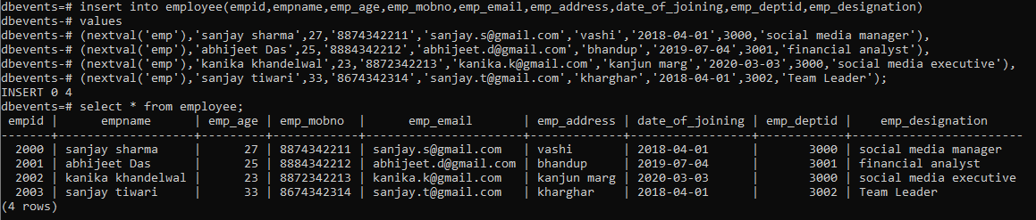
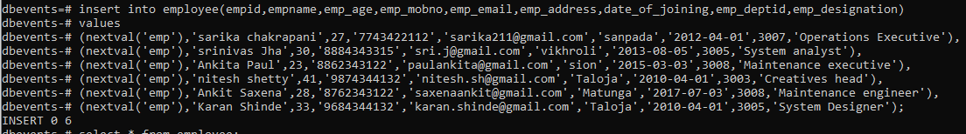
Employee

Slide 47
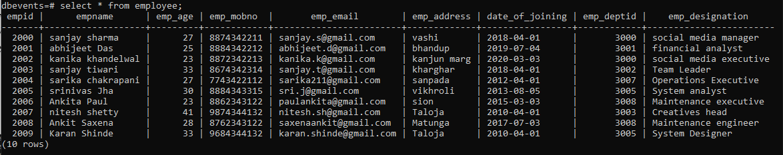
Employee

Slide 48
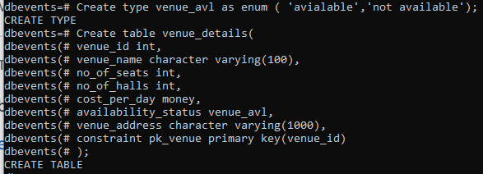

Venue Details

Slide 49

Venue Detail

Slide 50

Venue Detail

Slide 51


Reservation detail

Slide 52

Reservation Detail

Slide 53


Payment

Slide 54


Payment

Slide 55

1.Fetch customer name and contact no of age between 18-40 in order
select cust_name,cust_mobno,cust_age FROM customer WHERE cust_age BETWEEN 18 AND 40 order by cust_age;

Slide 56

2.Fetch records of customer names who have made reservations along with date of event and event name

Slide 57

3. Fetch record of reservations with venue names and details Reservation id, Event name,date,venue id,venue name ,venue address

Slide 58

4.Sort the venue details in ascending order
select* from venue_details order by venue_name asc;

Slide 59

5. Get the the five venue name,costperday from the sorted venue details after skipping first 3 records;
select venue_name,cost_per_day from venue_details order by venue_name asc limit 5 offset 3;

Slide 60
6. Fetch the date of event year(only year) of reservation_detail of all reservation when reservation id is given as input.
select extract( year from((select date_of_event from reservation_detail where r_id=5002)))as "YEAR";

Slide 61

7.Fetch records of availability status of enum greater than available
select venue_name,availability_status from venue_details where availability_status=(select max(availability_status)from venue_details);

Slide 62

8. Fetch records of availability status of enum greater than available
select*from venue_details where availability_status>'avialable' order by availability_status;

Slide 63

9.Fetch record of customers with payment and reservation details
Select p.pid,r.r_id,c.cust_name,r.event_name,p.date_of_payment,p.Amount
from payment p,customer c,reservation_detail r
where p.r_id= r.r_id and r.cust_id = c.cust_id;

Slide 64

10. Fetch the total amount paid by each customer
select c.cust_id,r.r_id,SUM (amount) AS total
from payment p,customer c,reservation_detail r
where p.r_id= r.r_id and r.cust_id = c.cust_id GROUP BY c.cust_id,r.r_id ORDER BY total;

Slide 65

11.Fetch Records of employees who are working under various departments.
Select e.empid,d.dept_id,d.dept_name,e.empname,e.emp_designation from employee e
JOIN department d ON e.emp_deptid=d.dept_id;

Slide 66
THANK YOU

